Slide 1

The “Handmonizer”
Project Course
L28
Davide Lionetti, Antonios Pappas
Notes:
Hello everybody we are going to present our project called the handmonizer, a sophisticated harmonizer controlled by the hand of the singer. This tool is been developed to fulfill the desires of a specific artist, the jazz singer Maria pia de Vito. She was looking for an easy-to-interact instrument that could ease her actual setup.

Slide 2
What is the «Handmonizer»?
Artist-oriented vocal improvisation tool
Tailored to the needs of jazz singer Maria Pia De Vito
Goal: enhance the singer’s live One-Woman-Band performance

Slide 3
Artistic needs
Previous setup:
Eventide guitar harmonizer
Echoplex looping machine
Unnatural/mechanical interaction
Too many physical switches/knobs
Clicking noises

Slide 4

Introdution

Slide 5


Hand motion recognition
ML5.js interface, Handpose model
Returns the coordinates of 21 points
Features:
Palm center coordinates
Palm length (white line)
Palm slope (slope of the white line)

Slide 6

Supercollider algorithm

Slide 7
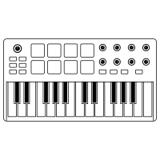



Architecture

Slide 8

Evaluation
Questionnaire covering different aspects of the performance
Answers: grade from 1 to 10 and a short comment
Can be used to evaluate similar future projects

Slide 9
Results and improvements

Slide 10
Demo

